Slide 1
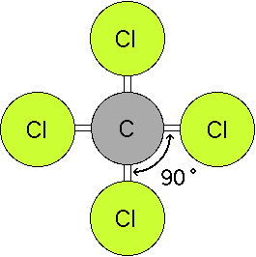
VSEPR Theory
Valence Shell Electron Pair Repulsion

Slide 2
VSEPR Theory
Predicts the molecular shape of a bonded molecule
Electrons around the central atom arrange themselves as far apart from each other as possible
Unshared pairs of electrons (lone pairs) on the central atom repel the most
So only look at what is connected to the central atom

Slide 3
These are for molecules with only paired electrons around the central atom.

Slide 4
Linear
2 atoms attached to center atom
0 unshared pairs (lone pairs)
Bond angle = 180º
Type: AB₂
Ex. : BeF₂

Slide 5
Trigonal Planar
3 atoms attached to center atom
0 lone pairs
Bond angle = 120º
Type: AB₃
Ex. : AlF₃

Slide 6
Tetrahedral
4 atoms attached to center atom
0 lone pairs
Bond angle = 109.5º
Type: AB₄
Ex. : CH₄

Slide 7
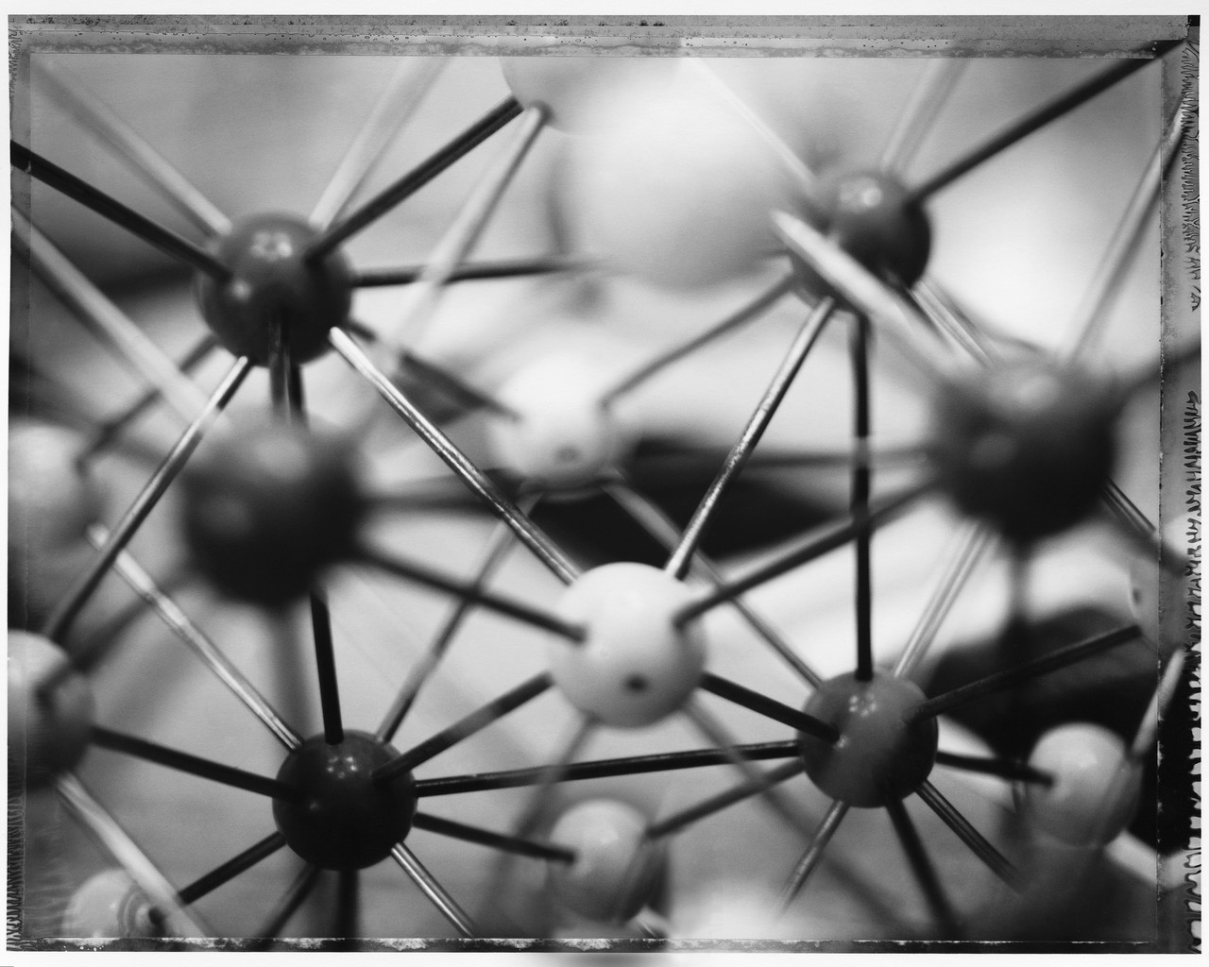
These are for molecules with both paired and unshared (lone) pairs of electrons around the central atom.

Slide 8
Bent
2 atoms attached to center atom
2 lone pairs
Bond angle = 104.5º
Type: AB₂E₂
Ex. : H₂O

Slide 9
Trigonal Pyramidal
3 atoms attached to center atom
1 lone pair
Bond angle = 107º
Type: AB₃E
Ex. : NH₃

Slide 10
