Slide 1
Significant Figures
Made Easy

Slide 2

Once upon a time……………..
Some friends decided to go to the hot new dance club downtown.

Slide 3

Club Significance
Significant Members Only

Slide 4
They got to the door all excited….

Slide 5

Club Significance
Significant Members Only
BAD

Slide 6
The bouncer was scary looking, but they all had identification so they weren’t worried at all.

Slide 7
As they showed their identification, the bouncer nodded and let each one pass. Until….

Slide 8
Suddenly, the bouncer gave a growl and said, “You aren’t significant fools. The Significant Club has rules.”
BAD

Slide 9


Slide 10
The others were inside dancing, and having a grand time. Not realizing that their friends were now on their way home totally confused as to what had just happened.

Slide 11
The next day at school…
They all met back up and the story was told. Together, they went to the library to find out what rules the bouncer was talking about.

Slide 12
What they found:
All nonzero numbers are significant.
When a zero is surrounded by nonzero numbers it is significant. If more than one zero is surrounded by nonzero numbers, the zeroes surrounded are ALL significant.
When a decimal is in the number, the first nonzero number present and all the numbers after it are significant.
Trailing zeros (at the end of a number) are ONLY significant if the number contains a decimal point.

Slide 13
But what does that mean?

Slide 14
They decided to work on the rules one at a time. Starting with the first rule.
All nonzero numbers are significant.
“This is why all of us that were not a zero got to go in but the others didn’t.”

Slide 15
They all agreed and decided to look at rule number two.
When a zero is surrounded by nonzero numbers it is significant. If more than one zero is surrounded by nonzero numbers, the zeroes surrounded are ALL significant. (506 → 3 sig figs!)
“So, if we go in with those that are not zeroes in the middle, the zeroes can come in. Like we are sponsoring them or saying they are part of our crew.”
“But does it matter how many zeroes are in the middle?”
“Nope, see it says that even if there is more than one zero surrounded, that all the surrounded zeroes are significant.”

Slide 16
They all agreed and decided to look at rule number three.
When a decimal is in the number, the first nonzero number present and all the numbers after it are significant.
“I think I get this one. Its like if you have a line and someone in the line has a credit card and says, ‘I am paying for myself and everyone behind me. The credit card is the decimal, and the guy that is using it is the first nonzero number that appears in the lineup.”

Slide 17
When a decimal is in the number, the first nonzero number present and all the numbers after it are significant
Example: 0.00452 has 3 sig figs
0.0000000000000000059 only has 2 sig figs

Slide 18
And now the final rule.
Trailing zeros (at the end of a number) are ONLY significant if the number contains a decimal point.
Example: 5.640 has 4 sig figs
120000. has 6 sig figs
120000 has TWO sig figs – unless you’re given additional information in the problem

Slide 19
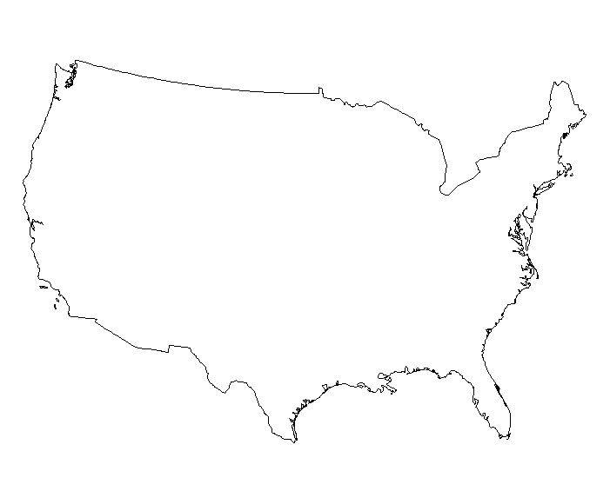
And now for a trick that will blow your mind.
Pacific
Atlantic

Slide 20
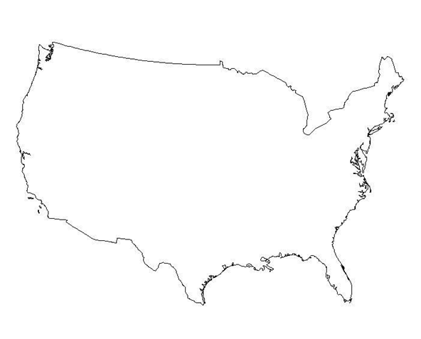
And now for a trick that will blow your mind.
P
A

Slide 21
If the decimal point is Present…
1. Move in from Pacific side
P
0.004000
A

Slide 22
If the decimal point is Present…
1. Move in from Pacific side
P
0.004000
A
2. Cross out zeros and start counting at the first non-zero number

Slide 23
If the decimal point is Present…
1. Move in from Pacific side
P
0.004000
A
2. Cross out zeros and start counting at the first non-zero number

Slide 24
If the decimal point is Present…
1. Move in from Pacific side
P
0.004000
A
2. Cross out zeros and start counting at the first non-zero number
3. Every number after that is significant!!

Slide 25
If the decimal point is Present…
1. Move in from Pacific side
P
4 sig figs!!
A
0.004000
2. Cross out zeros and start counting at the first non-zero number
3. Every number after that is significant!!

Slide 26
If the decimal point is Absent…
1. Move in from the Atlantic side
P
A
90,000,000
Notes:
90

Slide 27
If the decimal point is Absent…
1. Move in from the Atlantic side
P
A
90,000,000
2. Cross out zeros and start counting at the first non-zero number
Notes:
90

Slide 28
If the decimal point is Absent…
1. Move in from the Atlantic side
P
A
90,000,000
2. Cross out zeros and start counting at the first non-zero number
Notes:
90

Slide 29
If the decimal point is Absent…
1. Move in from the Atlantic side
P
A
90,000,000
2. Cross out zeros and start counting at the first non-zero number
3. Every number after that is significant!!
Notes:
90

Slide 30
If the decimal point is Absent…
1. Move in from the Atlantic side
P
A
1 sig fig!
90,000,000
2. Cross out zeros and start counting at the first non-zero number
3. Every number after that is significant!!
Notes:
90

Slide 31
They had the rules down and were ready to see if they could follow them to get into the club.
And now its your turn. Each of you will have an identification card. Can you arrange yourselves so that the numbers you make will allow you to get into the club too?
Let’s try it.

Slide 32
Explore
Students should each get an ID.
IDs are single digits from 0 to 9.
Have them arrange themselves to create numbers with a certain number of significant and insignificant numbers.
Added challenges: Require a certain decimal placement and/or scientific notation placements.

Slide 33
Explain:
Review with guided worksheets the rules for significant numbers.
Continue on to guided practices with using significant figures to round various measurements. This can take time, but one of the keys is to remind them that if I owe $4567 and the guy says he’ll be happy with it to three significant numbers, he won’t be pleased to get $457. The value must stay the same, we are just rounding to a certain degree of accuracy.

Slide 34
Elaborate
Time to take it to the next level. Use dimensional analysis word problems to help them figure out how to know how many significant figures their answers must have.

Slide 35
Evaluate:
Provide word problems involving various problems involving the activities that have been done for students to show mastery of the concept.

Slide 36
Added note of importance:
Always make sure to remind the students before they leave that no matter what number they were given as an ID or what various placements they were put in during the course of the activity, that they are significant to you.

