Slide 1
Naming Acids and Bases
Unit 5

Slide 2
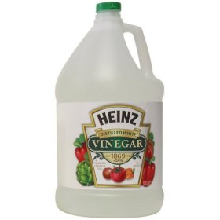
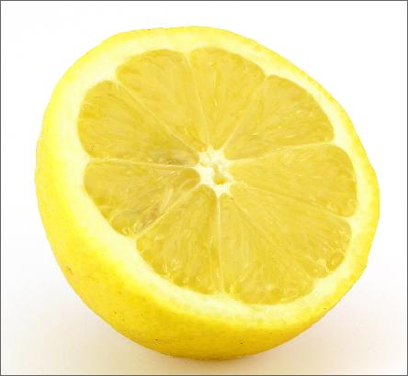
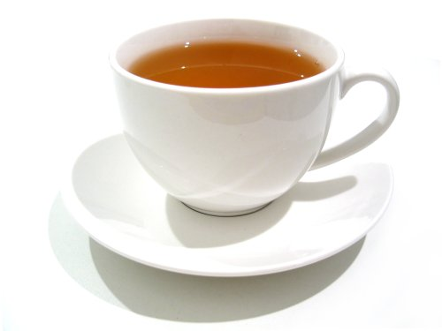
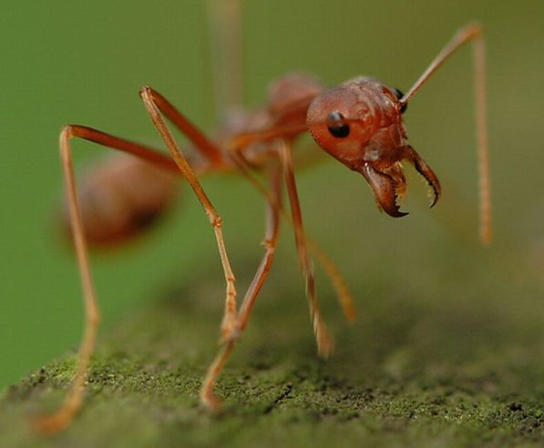
Acids
H⁺
Acid – a compound that produces ions when dissolved in
Examples:
Vinegar –
Lemon juice –
Tea –
Ant venom –
water
Acetic acid
Citric acid
Tannic acid
Formic acid

Slide 3
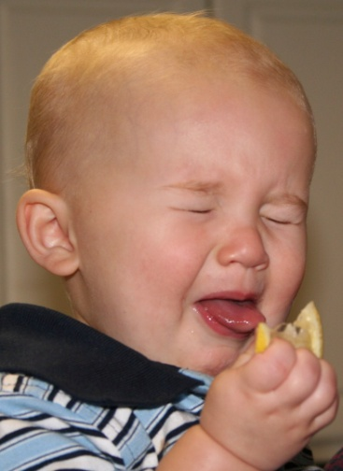
Properties of Acids
Sour
taste
Turns litmus paper
Reacts with metals to form gas
solutions of acids are
(must be mixed with water!)
Reacts with to form and
Corrosive
red
H₂
Aqueous
electrolytes
bases
H₂O
salt
Notes:
Litmus paper is an indicator.
Electrolytes can conduct electricity.
“Salt” is not always NaCl! It can be other ionic compounds.

Slide 4
Properties of Acids
Sugar, corn syrup, modified corn starch, citric acid, tartaric acid, natural and artificial flavors, yellow 5, yellow 6, red 40, blue 1
What ingredients make these…
so sour?

Slide 5
Naming Binary Acids
H + one other element
Begin with
Use the of the element name
Add the suffix
HCl
“hydro-”
root
“-ic”
hydro
chlor
ic
acid

Slide 6
Naming Binary Acids
Hydrobromic acid
HBr →
HI →
HF →
Hydroiodic acid
Hydrofluoric acid

Slide 7
Naming Ternary Acids
H + polyatomic ion
Begin with ion without
the
Add suffix if there was an
Add suffix if there was an
HNO₃ →
polyatomic
ending
-ic
-ate
-ous
-ite
Nitrate
Nitric acid

Slide 8
Naming Ternary Acids
Chloric acid
HClO₃ →
H₃PO₃ →
H₂CO₃ →
Phosphorous acid
Carbonic acid

Slide 9
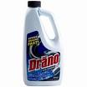
Bases
OH⁻
Base – a compound that produces ions
when dissolved in
Examples:
Milk of Magnesia – neutralizes stomach acid
Drain cleaner–
(hydroxide)
water
Magnesium hydroxide
Sodium hydroxide

Slide 10
Naming Bases
polyatomic
Use the same rules as for ions (name the cation, then name the anion)
NaOH →
Ca(OH)₂ →
KOH →
Sodium hydroxide
Calcium hydroxide
Potassium hydroxide

