Slide 1
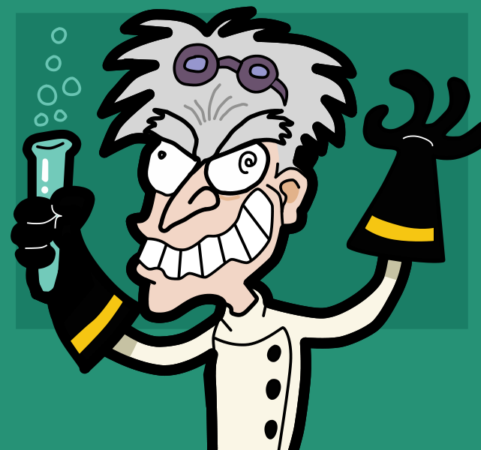
Laboratory Do’s and Don’ts http://www.youtube.com/watch?v=yclOrqEv7kw

Slide 2
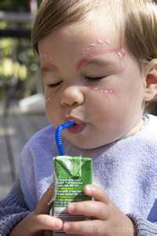
Find My Rule No No

Slide 3
Find My Rule Yes No

Slide 4
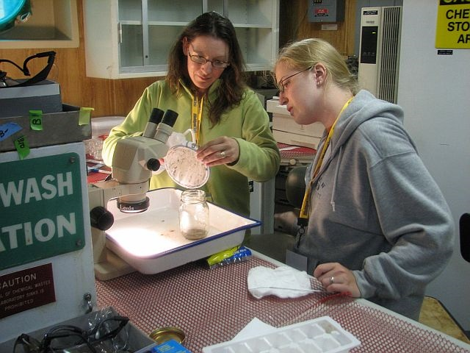
Find My Rule Yes No

Slide 5
Find My Rule Yes No No

Slide 6
Stand and Share
Find a partner and read the rules assigned to your group. (5 minutes)
Select two rules from these and plan how you will present Do’s and Don’ts for those rules. Poster, drawings, skits, etc. (15 minutes)
Each pair takes turns presenting their Do’s and Don’ts to the class.

